Slide 1
Structural Design Pattern
Parinya Ekparinya
Parinya.Ek@kmitl.ac.th
Software Architecture and Design

Slide 2
Acknowledgement
The content of the following slides are partially based on the listed material as follows:
Object-Oriented Patterns & Frameworks by Dr. Douglas C. Schmidt
https://en.wikipedia.org/wiki/Facade_pattern
https://en.wikipedia.org/wiki/Composite_pattern
https://en.wikipedia.org/wiki/Decorator_pattern
https://en.wikipedia.org/wiki/Proxy_pattern
https://en.wikipedia.org/wiki/Flyweight_pattern

Slide 3
WARNING: Overuse of design patterns can lead to code that is downright over-engineered. Always go with the simplest solution that does the job and introduce patterns only where the need emerges.
Freeman, E., Robson, E., Bates, B., & Sierra, K. (2008). Head first design patterns. " O'Reilly Media, Inc."

Slide 4
Structural Design Patterns
Façade
Composite
Decorator
Proxy
Flyweight

Slide 5


Facade

Slide 6
Facade: Problem
How to make a complex subsystem easier to use?
How can the dependencies on a subsystem be minimized?
Applicability
A simple interface is required to access a complex system.
A system is very complex or difficult to understand.
An entry point is needed to each level of layered software.
The abstractions and implementations of a subsystem are tightly coupled.

Slide 7
Facade: Solution
Intent
Provide a unified interface to a set of interfaces in a subsystem.
What solution does the Facade design pattern describe?
Define a façade object that implements a simple interface in terms of (by delegating to) the interfaces in the subsystem.
Such a façade object may perform additional functionality before/after forwarding a request.

Slide 8
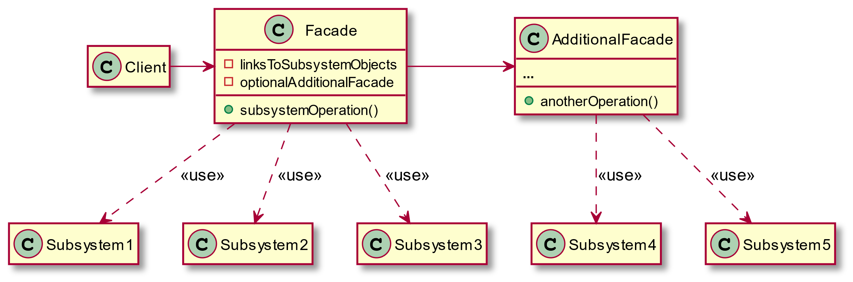

Slide 9
Facade: Consequences
Client code can be isolated from the complexity of a subsystem.
A facade can become a god object!!

Slide 10
Facade: Examples
Facade (refactoring.guru)
Facade pattern - Wikipedia

Slide 11


Composite
Also known as: Object Tree

Slide 12
Composite: Problem
How to represent a part-whole hierarchy so that clients can treat part and whole objects uniformly?
How to represent a part-whole hierarchy with tree structure?
Applicability
Objects must be composed recursively.
No distinction between individual & composed elements.
Objects in structure can be treated uniformly.

Slide 13
Composite: Solution
Intent
To treat individual objects & multiple, recursively-composed objects uniformly.
What solution does the Composite design pattern describe?
Define a unified Component interface for both part (Leaf) objects and whole (Composite) objects.
Individual Leaf objects implement the Component interface directly, and Composite objects forward requests to their child components.

Slide 14
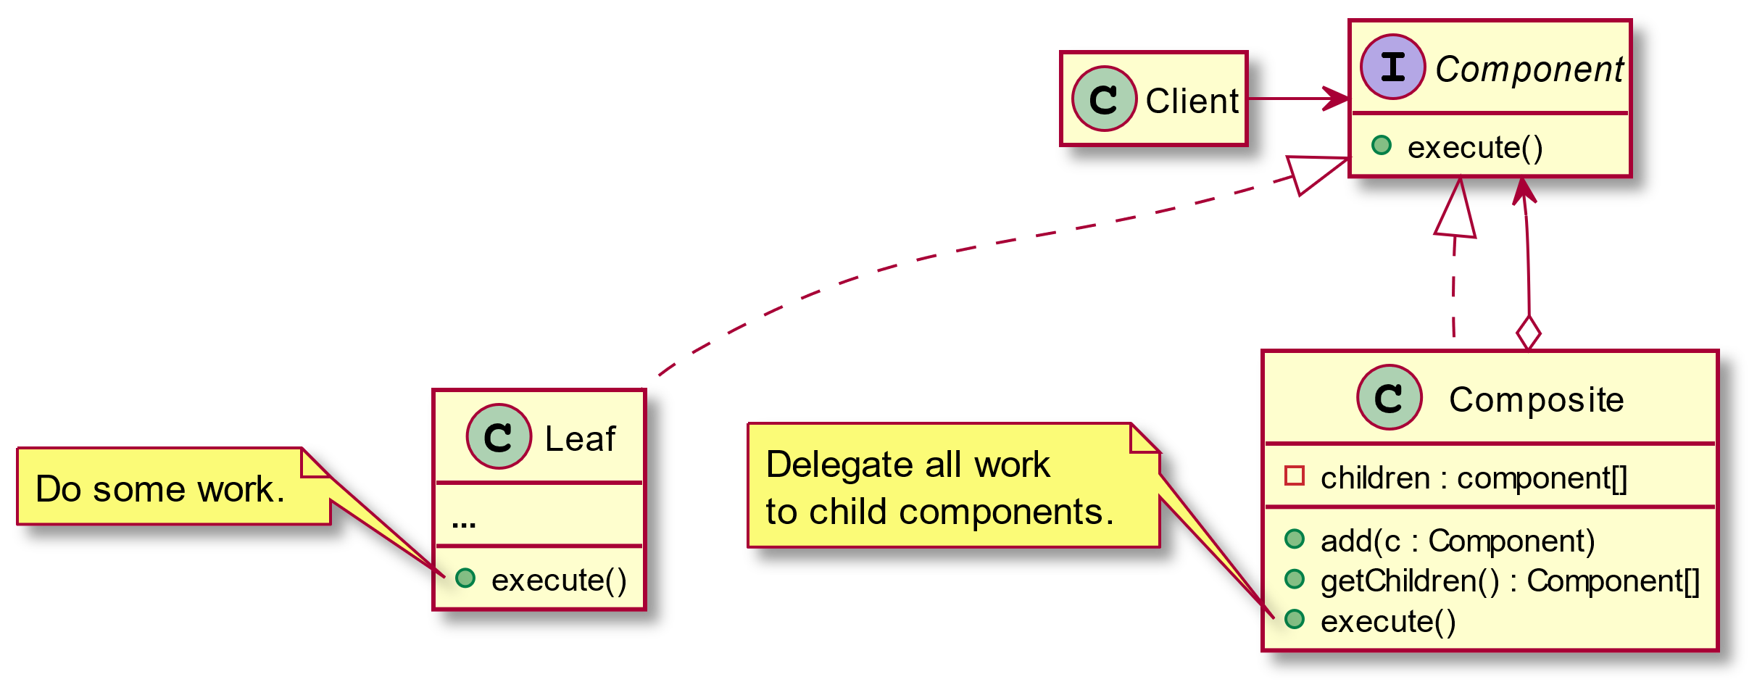

Slide 15
Composite: Consequences
Uniformity: treat components the same regardless of complexity.
Extensibility: new Component subclasses work wherever old ones do.
Overhead: might need prohibitive numbers of objects.
Awkward designs: may need to treat leaves as lobotomized composites in some cases

Slide 16
Composite: Examples
Composite (refactoring.guru)
Composite pattern - Wikipedia

Slide 17

Decorator
Also known as: Wrapper

Slide 18
Decorator: Problem
How to add responsibilities to (and removed from) an object dynamically at run-time?
How to provide a flexible alternative to subclassing for extending functionality?
Applicability
When responsibilities are needed to add to individual objects dynamically and transparently.
When such responsibilities can be withdrawn from objects.
When extension by subclassing is impractical.

Slide 19
Decorator: Solution
Intent
To attach additional responsibilities to an object dynamically.
What solution does the Decorator design pattern describe?
Define decorator objects that implement the interface of the extended (decorated) object (Component) transparently by forwarding all requests to it.
Such decorator objects may perform additional functionality before/after forwarding a request.

Slide 20
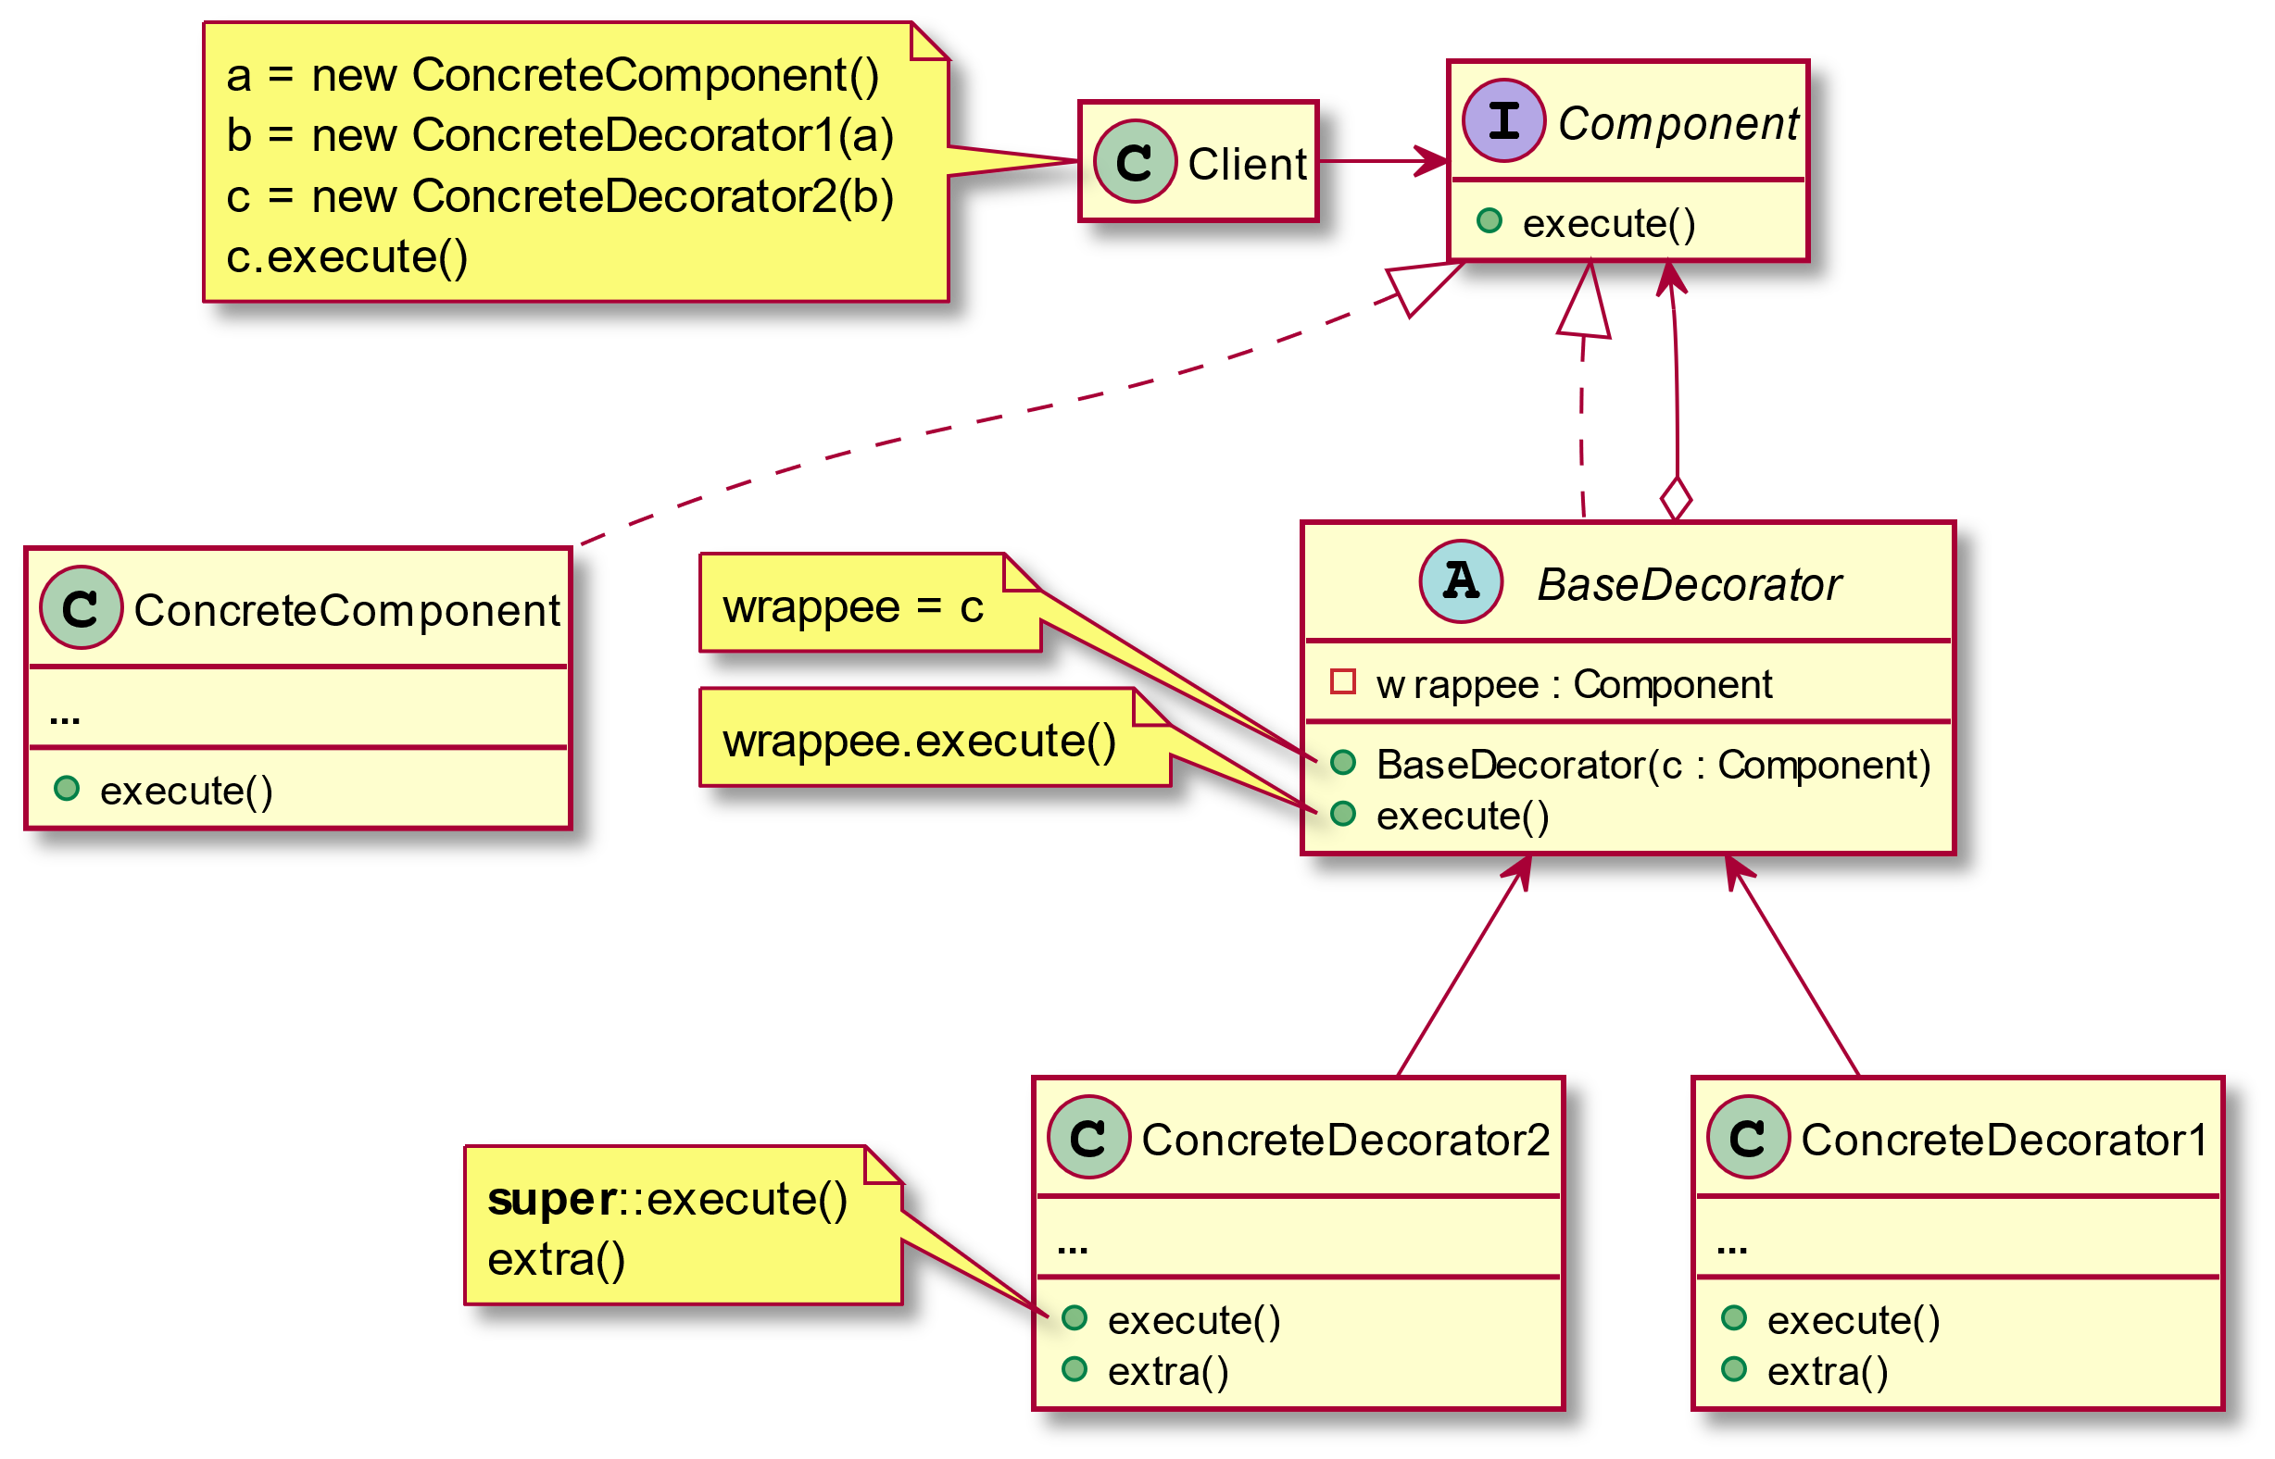

Slide 21
Decorator: Consequences
Add or remove responsibilities from an object at runtime.
SRP: many variants of behavior can be implemented with several smaller classes.
Hard to remove a specific wrapper from the wrappers stack.
Certain variants of behavior may depend on the order of the decorators stack.

Slide 22
Decorator: Examples
Decorator (refactoring.guru)
Decorator pattern – Wikipedia

Slide 23

Proxy

Slide 24
Proxy: Problem
How to control the access to an object?.
How to provide additional functionality when accessing an object?
Applicability
There are dozen ways to use this pattern. See https://refactoring.guru/design-patterns/proxy

Slide 25
Proxy: Solution
Intent
Provide a surrogate or placeholder for another object to control access to it.
What solution does the Proxy design pattern describe?
Define a separate proxy object that can be used as substitute for another object (Subject).
Such a proxy object implements additional functionality to control the access to this subject.

Slide 26
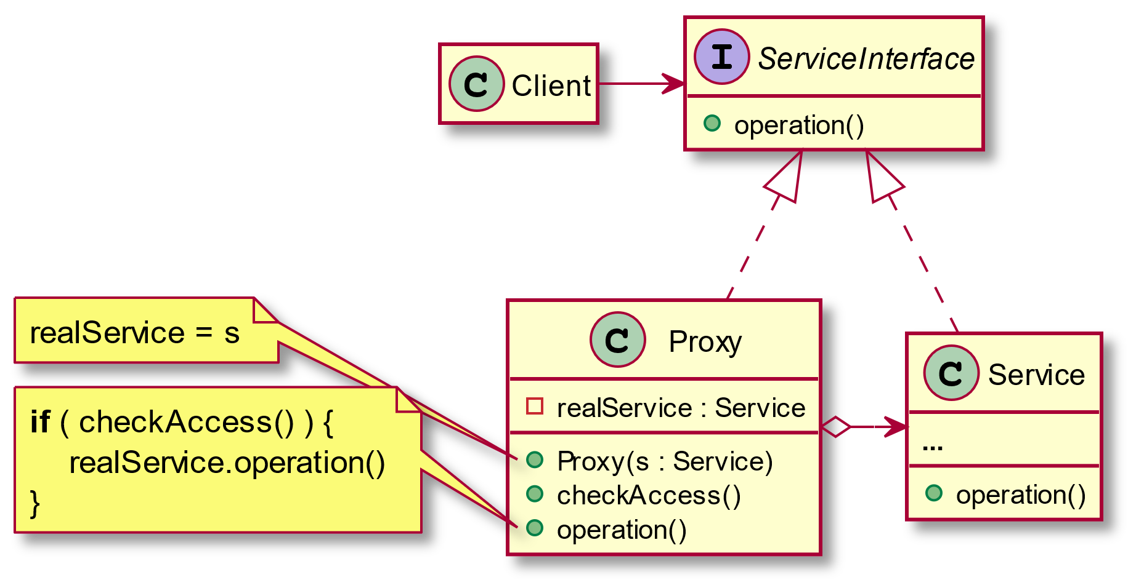

Slide 27
Proxy: Consequences
Service object can be controlled without clients’ awareness.
OCP: introduction new proxies without change service or clients.
Overhead: the response from the service might get delayed.

Slide 28
Proxy: Examples
Proxy (refactoring.guru)
Proxy pattern – Wikipedia

Slide 29

Flyweight

Slide 30
Flyweight: Problem
How to minimizes memory usage by sharing some of object data with other similar objects?
Applicability
An application needs to spawn a huge number of similar objects.
The objects contain duplicate states which can be extracted and shared between multiple objects.

Slide 31
Flyweight: Solution
Intent
To use sharing to support large numbers of fine-grained objects efficiently.
What solution does the Flyweight design pattern describes?
Define a flyweight object to store shared intrinsic state, constant data of objects.
Extrinsic state, the rest of the object’s state that can be altered, should be stored in another object with a reference to a flyweight object.

Slide 32
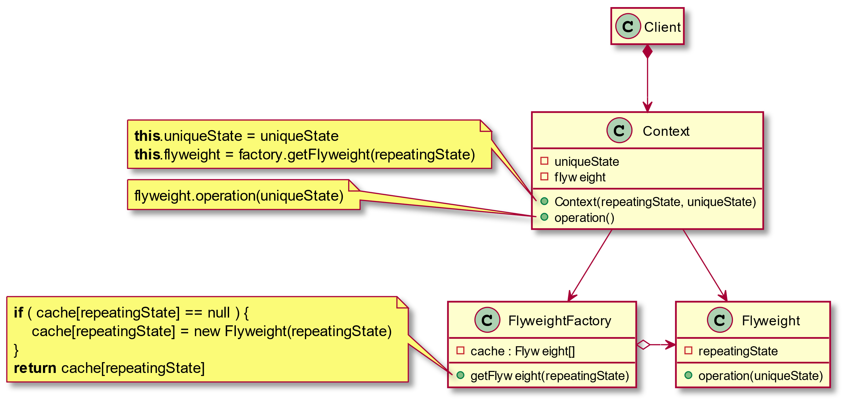

Slide 33
Flyweight: Consequences
Save lots of RAM!!
Trading RAM over CPU cycles in some cases.
The code can become much more complicated.

Slide 34
Flyweight: Examples
Flyweight (refactoring.guru)
Flyweight pattern – Wikipedia

